Slide 1


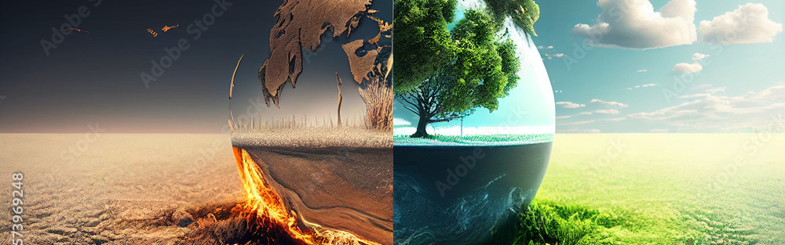
Exploring Climate Change name – ANANYA DEY
Understanding causes, impacts, and solutions

Slide 2
Causes of Climate Change
- Fossil Fuels (57%)
- Deforestation (17%)
- Agriculture (14%)
- Industrial Processes (6%)
- Natural Causes (6%)

Slide 3

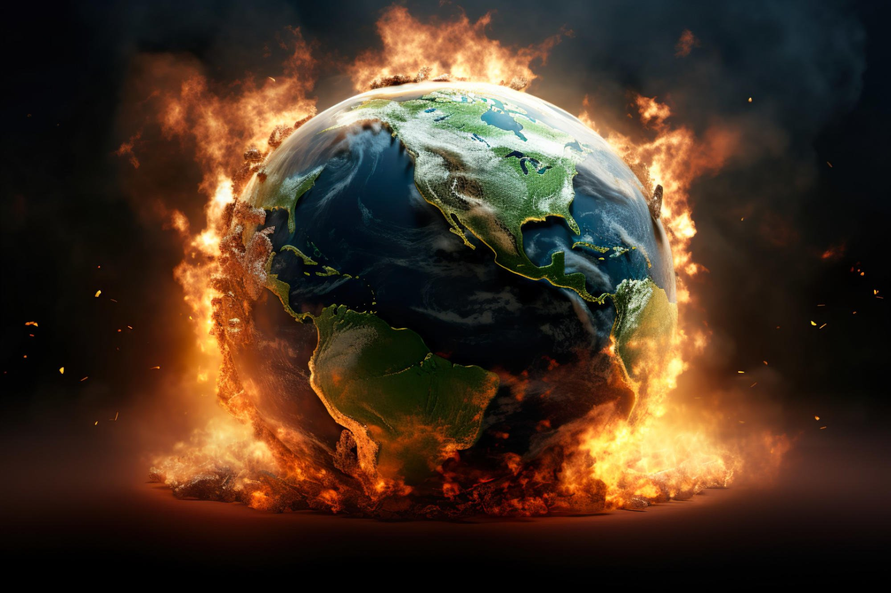
Global Impact of Climate Change
Table:
Metric | 1900 | 2020 | 2050 (Projected)
-----------------------------------------
Temp (°C) | +0.1 | +1.1 | +2.0 to +3.5
Sea Level (cm) | 0 | +20 | +40 to +70
Ice Extent (M km²) | 7.0 | 4.2 | <2.0
Forest Loss (M ha) | — | ~100 | —
Voiceover: Earth is changing — accelerating impacts.

Slide 4
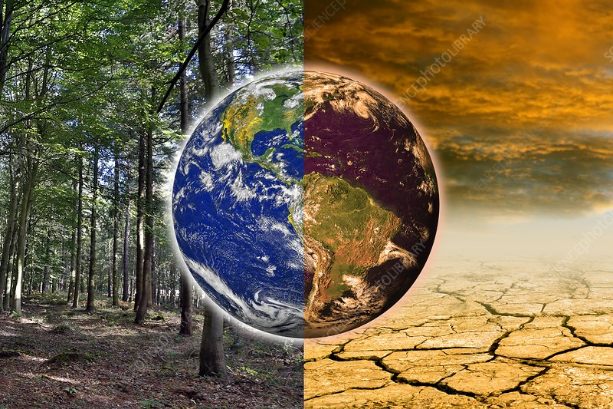
Global Solutions
Solutions Table:
- Solar/Wind Energy: High impact
- Carbon Tax: Medium
- Reforestation: High
- Electric Vehicles: Medium
- Recycling & Efficiency: Medium
Video: UN Climate Action Solutions (YouTube)

Slide 5
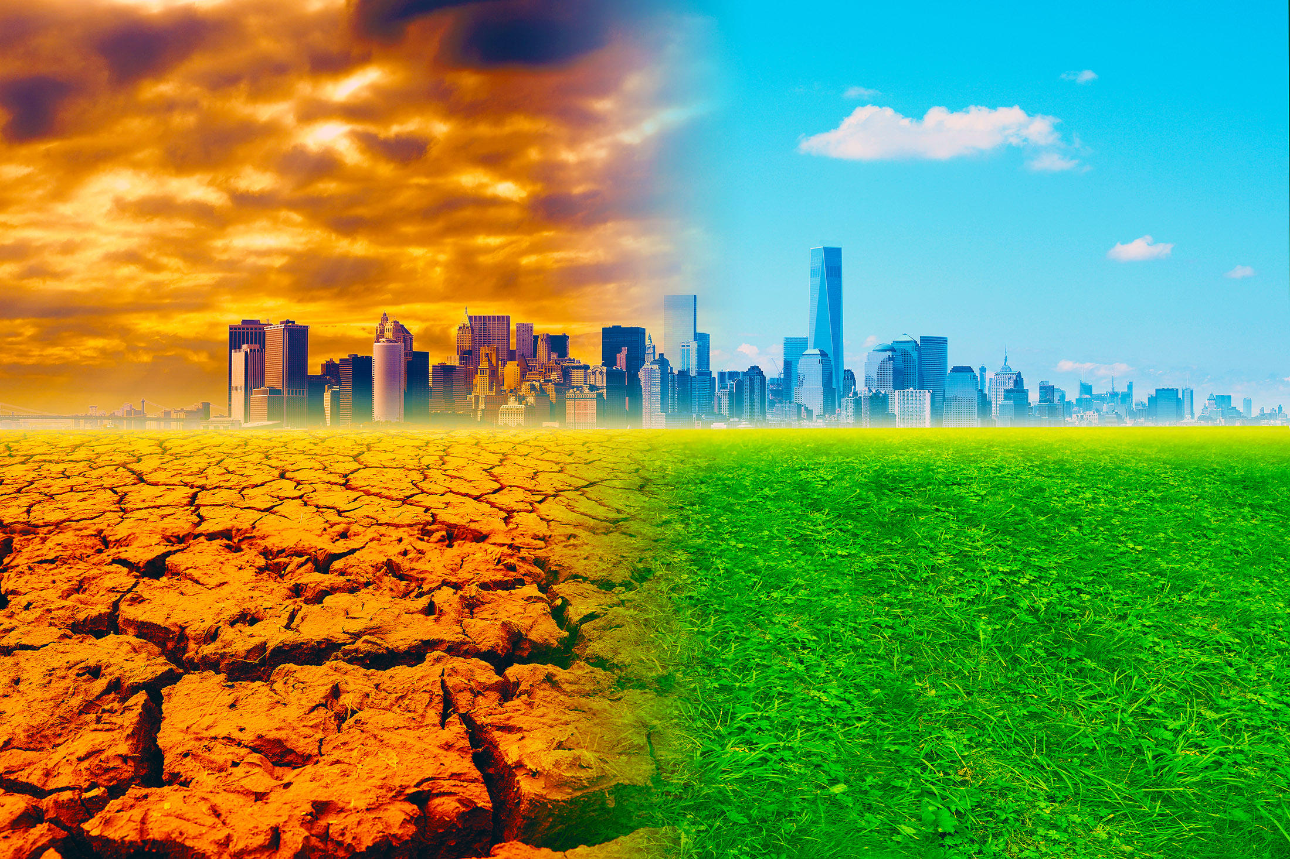
Individual Actions Matter
Bar Chart (not shown):
- Going car-free: 2,400 kg/year
- Switching to LEDs: 400 kg/year
- Recycling more: 600 kg/year
- Plant-based meals: 1,000 kg/year
Sound Effects: Light switch, bike bell, leaves

Slide 6
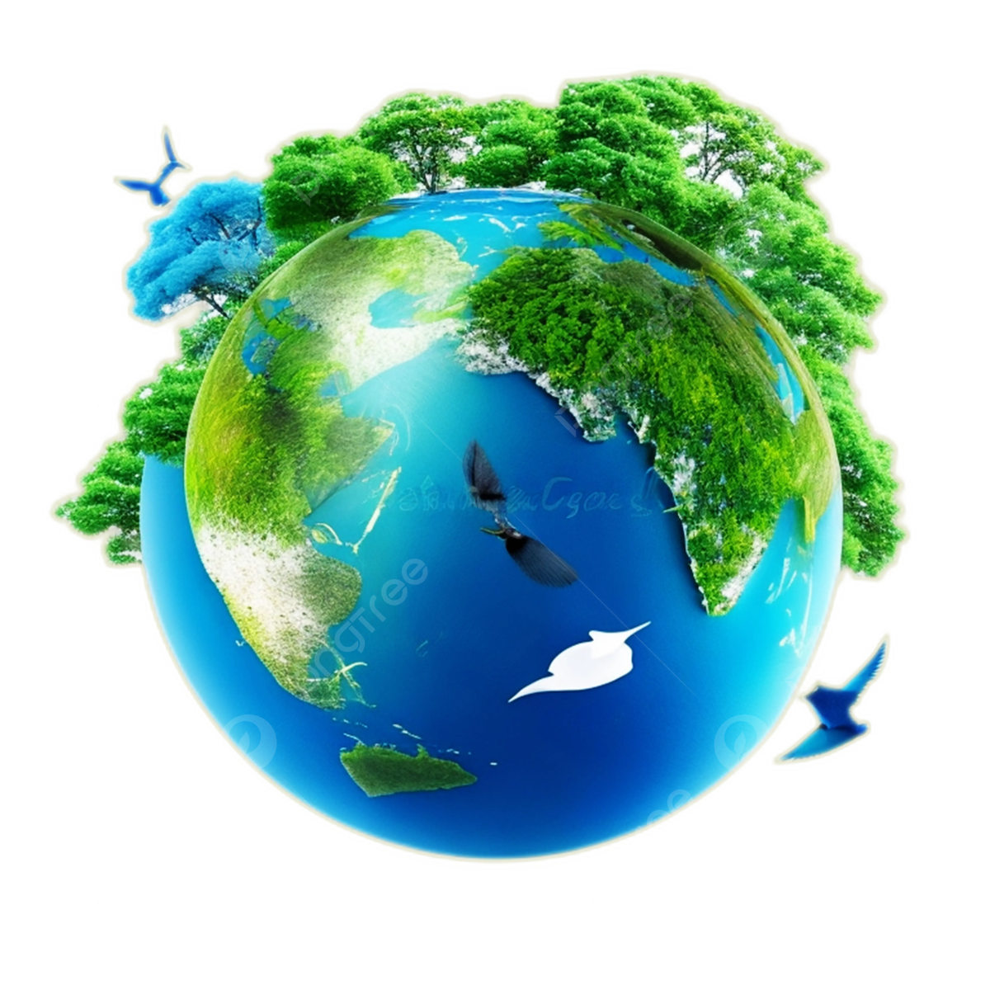
Act Now for Our Future
Video Montage: Planting trees, youth marches, wildlife
"Climate change isn’t just a future problem—it’s now. Every action counts. Be part of the solution. Speak up. Show up. Start today."

